Slide 1
secure data hiding in images using steganography
CAPSTONE PROJECT
Presented By: Sahaya Dharshini A
Student Name : Sahaya Dharshini A
College Name & Department : Loyola –ICAM College Of Engineering and Technology | Btech Information Technology

Slide 2
OUTLINE
Problem Statement
Technology used
Wow factor
End users
Result
Conclusion
Git-hub Link
Future scope

Slide 3
Problem Statement
To develop a steganographic system that integrates strong encryption with image-based data hiding, utilizing a secret key for both processes. The system must ensure that the hidden data remains undetectable to the human eye and resistant to steganalysis. Furthermore, it should guarantee reliable data retrieval through decryption, maintaining computational efficiency and secure key management.

Slide 4
Technology used
Libraries:
cv2 (OpenCV):
This is the core library for image processing.
It's used for:
Reading images
Writing images .
Accessing and modifying pixel values within the image.
os:
This is the operating system interface library.
It's used for:
Executing system commands
string:
While you import this library, it is not actually used in the code provided.
Platforms:
Python:
This is the programming language in which the code is written.
Operating System (Any with Python and OpenCV):
The code should run on any operating system (Windows, macOS, Linux) that has Python and OpenCV installed.
OpenCV Installation:
OpenCV needs to be installed in the Python environment.

Slide 5
Wow factors
Integration of Strong Encryption:
Implement robust encryption algorithms (e.g., AES, RSA) to encrypt the message before embedding it.
Adaptive Embedding:
Dynamically changing the amount of data that is hidden based on the complexity of the image.
Advanced Embedding Techniques:
Hiding the data in the frequency domain of the image.
Steganalysis Countermeasures:
Implement techniques to make the steganography more resistant to steganalysis.
Error Correction:
Incorporate error correction codes (e.g., Reed-Solomon) to ensure that the hidden data can be recovered even if the image is slightly corrupted.
Unique feature:
The ability to recover the hidden message, even if the image file has been slightly corrupted.
A secure method of generating and sharing the encryption key.
Secure Key Management:
Implement a secure way to generate, store, and distribute the encryption keys.

Slide 6
End users
Legitimate End-Users:
Cybersecurity Professionals:
They use steganography for:
Digital watermarking and copyright protection.
Concealing sensitive data like encryption keys or authentication credentials.
Analyzing and detecting malicious steganographic activity.
Intelligence Agencies and Law Enforcement:
For covert communication and information gathering.
Journalists and Activists:
To protect sensitive information and communicate securely in environments with censorship or surveillance.
Individuals Concerned with Privacy:
For hiding personal data within digital files.
Medical Professionals:
To hide patient information inside of medical imagin

Slide 7
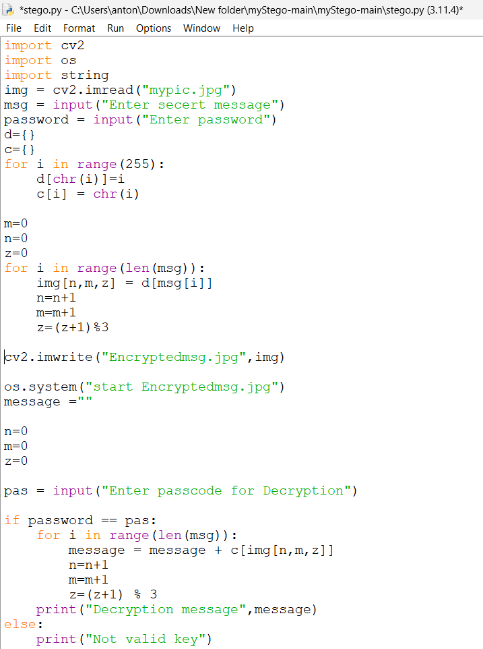
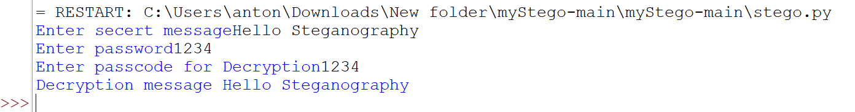
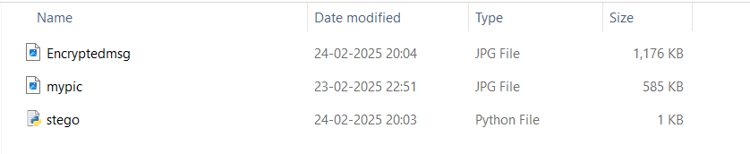
Results

Slide 8
Conclusion
Educational Foundation: The project serves as a basic demonstration of LSB steganography principles.
Security Limitations: The current implementation is highly vulnerable to steganalysis and lacks essential security features like encryption.
Need for Enhancement: Significant improvements are necessary for practical security and robustness.
Encryption Integration: Strong encryption algorithms are crucial for protecting hidden data.
Adaptive Embedding: Techniques to dynamically adjust data hiding based on image characteristics are needed.
Steganalysis Countermeasures: Effective defenses against detection are essential.
Key Management and Error Correction: Robust systems for key handling and data recovery are vital.
Real-World Application: The project highlights the potential of steganography but emphasizes the need for advanced techniques for practical use.

Slide 9
GitHub Link
https://github.com/sahaya-dharshini-a/project_Steganography.git

Slide 10
THANK YOU

